Slide 1
Federal Reserve Bank of Boston
CT Council for Philanthropy
Children’s Savings Accounts (CSAs)
Anthony Poore
Tuesday, December 8, 2015
“The views expressed here do not necessarily represent those of the Federal Reserve Bank of Boston or the Federal Reserve System”

Slide 2
What are Children’s Savings Accounts (CSAs)
Long-term asset-building accounts established for children, as early as birth, and allowed to grow over their lifetime.
Two Product Models
A deposit-only savings account offered by traditional lender. (K2C Model, San Francisco)
A 529 savings plan (named for the relevant section of the federal tax code) is a state-sponsored, tax-preferred savings plan for qualified post-secondary education expenses. (Harold Alfond, Maine)
Either model can provide savings matches or other incentives to encourage positive savings behaviors – particularly those of lower income – to save.

Slide 3
Principles of Effective CSA Design
Allow universal, automatic child enrollment.
Carry a national footprint and equitable among different jurisdictions.
Allow identification and engagement with accounts, including parent and child deposits, in-person and via electronic interface.
Restrict accounts to asset-building purposes, but not strictly to higher education.
Be administratively efficient in all essential operations, including disbursement, and sustainable at scale, with tolerably low administrative costs and integration into existing policy systems.
Adequately protect consumers, with publicly provided accounts or private accounts with substantial regulatory oversight
Moving Toward a Policy Agenda for Improving Children's Savings Account Delivery Systems William Elliott III, Melinda K. Lewis, Anthony Poore, and Brian Clarke, Community Development Issue Brief, No. 1, 2015

Slide 4
Why Do We Care?
The cost of post-secondary education & student loan debt is having a profound impact on the daily lives & long-term financial health of many young adults.
CSAs have the potential to expand economic and educational opportunities for low- and moderate income families & children.
CSAs support the interest of States in increasing the percentage of its population with college degrees, certificates and credentials (Lumina Foundation Goal 2025).
Connecticut’s Goal: N/A College Attainment among Adults Ages 25-64 : 47.8%
CSAs represent a long term investment in our citizenry while helping address and alleviate New England’s/Connecticut’s middle skills gap by addressing secondary education affordability.
CSA’s encourage and leverage, family, public and private capital resources.

Slide 5
Major Developments in the CSA Field

Slide 6
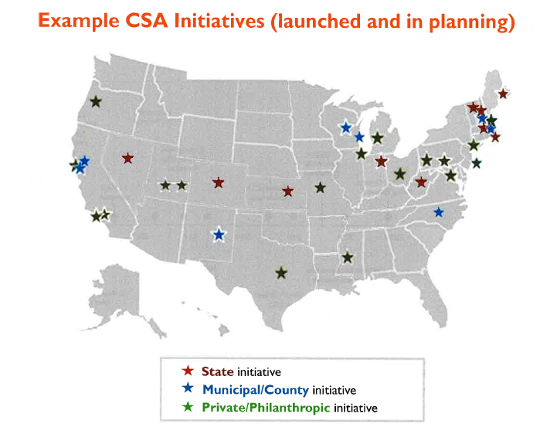
New England Leads the Nation

Slide 7
New England Leads the Nation

Slide 8
New England Leads the Nation

Slide 9
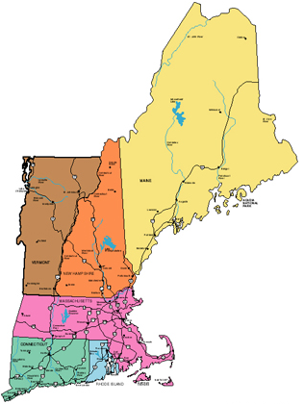
New England Leads the Nation
Three New England State Legislators have sponsored/passed CSA Legislation in 2015
Vermont: Rep. Jill Krowinski
New Hampshire: Rep. Mary Gile
Massachusetts: Sen. James Eldridge & the City of Boston, Treasurer Goldberg

Slide 10
CSAs Continue to Gain Momentum
Regional
New England Board of Higher Education
Federal Reserve Bank of Boston
National
National League of Cities Institute for Youth, Education and Families’ Learning Collaborative
National Conference of State Legislatures
Campaign for Every Kid’s Future Corporation for Enterprise Development (CFED)

Slide 11
What Does Early Research Suggest: Assets, Empowerment & Opportunity
College Readiness
Higher student and parental college expectations.
Weak but positive effects on reading & math.
Higher high school GPA
College Bound Identity
College Access
Even college savings of less than $500 increase college entry for low and moderate income students.
3Xs more likely to enroll in college than with no savings account.
College Savers Identity
Elliot, W. and Lewis (2013). Are student loans widening the wealth gap in America? It’s a question of equity. Lawrence, KS: Assets & Education Initiative (AEDI).

Slide 12
What Does Early Research Suggest: Assets, Empowerment & Opportunity
College Completion
Even college savings of less than $500 increase college completion for low and moderate income students.
4Xs more likely to graduate college than with no savings account.
Young adult graduates who had savings as adolescents:
2Xs more likely to own savings accounts (banked/unbanked)
2xs more likely to own credit cards
4xs more likely to own stocks
Elliot, W. and Lewis (2013). Are student loans widening the wealth gap in America? It’s a question of equity. Lawrence, KS: Assets & Education Initiative (AEDI).

Slide 13
What’s the Future Look Like for the Federal Reserve Bank of Boston?
3-5 year commitment
Focus: State Policy, Practice and Research
Roles: Convener, Technical Assistance Provider, Research Partner
Areas of Focus
Interim Outcome/Impact Measures
Child/Parent & Community Engagement Strategies
Long Term Research Opportunities (Impact)

Slide 14
Summary
Children’s Savings Accounts (CSAs) are not necessarily superior to other financial aid approaches for the sole purpose of paying for college but…
When considered through a lens that looks beyond mere access, to account for the role of assets in helping children prepare for, engage with, and benefit from college, there may be no other single policy lever as well-suited to these challenges as CSAs.

Slide 15
Anthony Poore
Deputy Director, R&CO
anthony.poore@bos.frb.org
www.bostonfed.org/commdev/childrens-savings-accounts

